Slide 1
Malaria in Children – Overview
Dalton Wamalwa
Associate Professor
Department of Paediatrics & Child Health

Slide 2
Case study SW
SW a 18 month old baby presents with a 2- day history of fever, vomiting and irritability 2 weeks after returning from Western Kenya.
On examination:
- Sick-looking and irritable
- Febrile (Temp 39.2⁰C)
- Pale
- Neck is soft
- Deep breathing and lower chest in-drawing
- Palpable spleen (2 cm below costal margin)

Slide 3
Case study – SW (2)
What is the most likely diagnosis ?
Her results: Hb 4.5 g/dl, Malaria smear +VE
State 3 life-saving measures that should be instituted
What additional co-morbid conditions should be considered?

Slide 4
Introduction
Malaria is the most important parasitic disease of man.
Global burden (2017):
219 million new infections each year (90% in Africa)
450,000 deaths (> 90% in Africa)
Over 70% of deaths in children < 5 years old.
Burden in Kenya:
Malaria incidence: 4 million cases and nearly 16000 deaths
Most deaths in children < 5 yrs, pregnant women
Notes:
World map showing malaria distribution

Slide 5
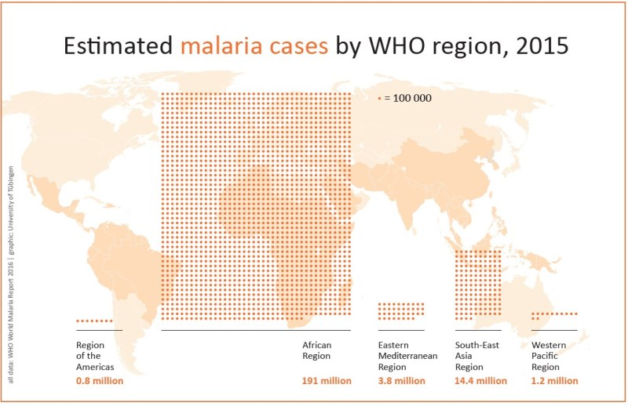

Slide 6
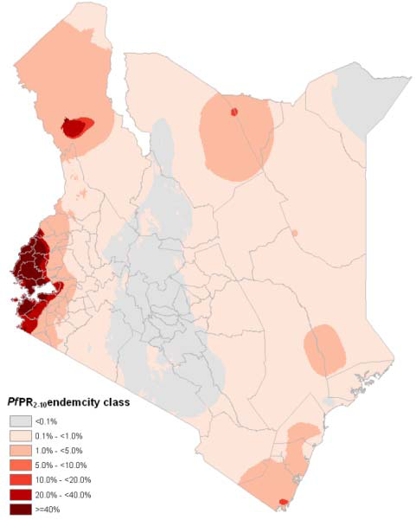
Malaria endemicity in Kenya
Spleen rate /parasite rate 2-9 year olds
Hypoendemic < 10%
Mesoendemic 11-50%
Hyperendemic > 50%
Holoendemic > 75%
Notes:
Risks could rebound to the historically high levels if control is not maintained

Slide 7
The malaria parasite
Plasmodium falciparum is the:
predominant species (98 %)
responsible for severe malaria and mortality
Others :
P.vivax (South America , Asia)
P. malariae, & P. ovale (endemic areas of Africa) ,
P. knowlesi (Zoonosis)
Vector : Anopheles (41 species in Kenya)
A. gambiae and A. funestus key
Notes:
Potential for removal

Slide 8
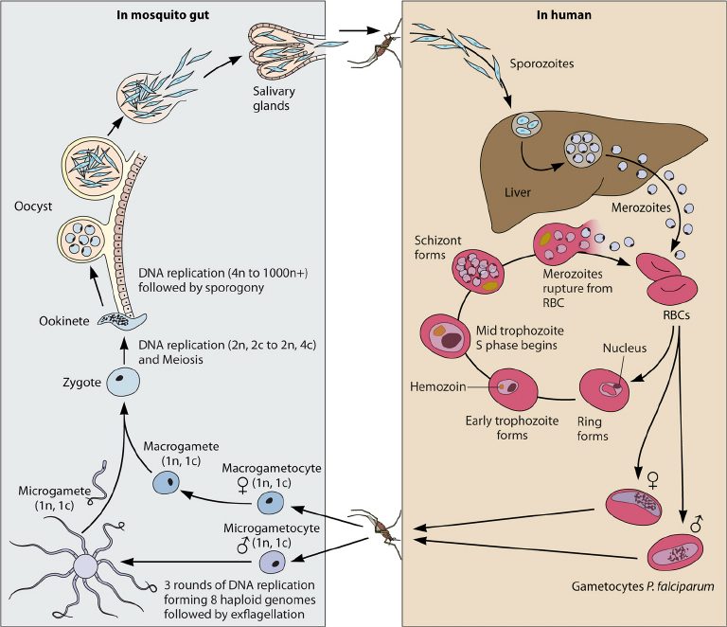
Life cycle
A. Pre- erythrocytic stage
Sporozoites injected : blood
Within 45 minutes either cleared or enter hepatocyte
B. Asexual liver stage
Hepatic schizoint rupture
C. Asexual blood stage
Merozoites infect RBC
Subset develop-gametocytes
D: Sexual stage in mosquito
B
C

Slide 9
Severe Malaria
Clinical or laboratory evidence of vital organ dysfunction in presence of Plasmodium in peripheral blood
Patients suspected to have severe malaria should be treated with parenteral therapy.
Lab results should not delay treatment

Slide 10
Three main overlapping syndromes in severe malaria in children (Marsh K 1995)
Severe malarial
anaemia
Cerebral malaria
Respiratory distress
Lactic acidosis
Blood transfusion
Impaired consciousness –predicts death

Slide 11
Hallmarks of severe malaria- clinical (WHO)
Impaired consciousness or unarousable coma GCS < 11/15 | Prostration (generalized weakness; unable to walk or sit up without assistance) | Circulatory collapse or shock (systolic blood pressure < 50 mm Hg in children) | Clinical jaundice plus evidence of other vital organ dysfunction
Multiple convulsions (> 2 episodes in 24 hours) | Deep breathing, respiratory distress (acidotic breathing) | Abnormal spontaneous bleeding | Pulmonary oedema (radiologic)
Failure to feed

Slide 12
Hallmarks of severe malaria –laboratory (WHO)
Metabolic acidosis (plasma bicarbonate level < 15 mM) | Hyper-lactatemia (lactate level > 5 mM) | Hyper-parasitemia -(> 2% or 100,00 parasites/mL in low-intensity transmission areas - > 5% or 250,00 parasites/mL in areas of high, stable malaria transmission intensity | Renal impairment (serum creatinine level > 265 mmol/L)
Hypoglycemia (blood glucose level < 2.2 mM) | Severe normocytic anemia (hemoglobin level < 5 g/dL) | Hemoglobinuria | Severe thrombocytopenia

Slide 13
Severe Malaria: Cerebral malaria
Risk factors:
in high transmission areas: children < 5 years
in low transmission areas :older children, adults
Blood groups (O protective, A and B higher risk)
High rates of mortality and permanent neurologic sequelae
Patient unable to localize painful stimulus, no other cause of encephalopathy and asexual malaria parasite present

Slide 14
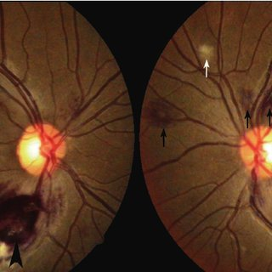
Severe malaria- cerebral malaria
Clinical: fever– convulsions– impaired level of consciousness— coma
Other manifestations: enlarged liver, spleen, abnormal bleeding, jaundice
Retinopathy: retinal bleeds, papilledema
Always exclude other causes: viral, bacterial

Slide 15
Postulated mechanisms of cerebral malaria
Not well known but most likely multifactorial
Sequestration and cytoadherence
Endothelial dysfunction, Vascular endothelium, Vascular leakage
Inflammatory cytokine response – TNF, IF, IL
Impaired Perfusion- Low cerebral blood flow Cerebral anaerobic glycolysis
Hypoxia and lactate acidosis

Slide 16
Severe Malaria- Patho-physiology
Cytokines
Plasmodium leads to release of cytokines
TNF, IL-1, IFN γ : inflammatory – fever & malaise
Cyto-adherence & Sequestration
RBC with mature forms adhere to micro-vascular endothelium (starts 12 hrs after merozoite invasion)

Slide 17
Severe Malaria : Respiratory distress
Presents as labored or deep breathing , nasal flaring, tachypnea, intercostal or subcostal recession
Is directly related to disease severity ; NOT caused by hypoxia
Ugandan study 516 / 855 (60%) children with severe malaria had respiratory distress
Only 42 (8%) children had hypoxia (arterial oxygen sat < 90%)
71% had lactate levels > 5mM and 94% > 2mM
Respiratory distress represents respiratory compensation to lactic acidosis and not respiratory drive due to hypoxia/lung disease

Slide 18
Severe Malaria : Anemia
Common in young children and is multifactorial:
Obligatory destruction of parasitised RBC at schizoint rupture( contributes 10%)
Accelerated destruction of non-parasitised RBC (contributes 90%)
Splenic threshold lowered: removes large numbers of rigid RBC
Shortened survival of RBC after splenic parasite removal
Bone marrow dyserythropoiesis – days to wks

Slide 19
Different manifestations based on transmission rates

Slide 20
Who is at risk for severe malaria ?
In high-transmission areas, risk greatest among:
Young children ( not neonates)
Visitors (any age) from non-endemic areas.
In low transmission areas severe malaria more evenly distributed across all age groups.
Risk is increased in the 2nd-3rd trimesters of pregnancy
Patients with HIV/AIDS : increased risk

Slide 21
Clinical suspicion of malaria
Symptoms of malaria are highly variable therefore high index of suspicion
All children from (or returning from) endemic zones presenting with fever.
Concurrently consider routine pediatric infections
viral and bacterial respiratory tract infections, infectious diarrhea, and urinary tract infections.
For children with fever and altered mental status or seizure: cerebral malaria may mimic bacterial meningitis

Slide 22
Diagnosis of Malaria
Efforts should always be made to get parasitologic diagnosis.
In absence or delay of microscopy in areas of high transmission treat on clinical grounds:
Suspected severe malaria in all patients
All Children < 5 yrs

Slide 23
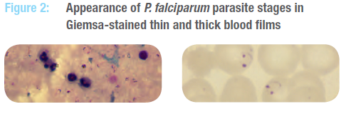
Parasitological diagnosis of severe malaria
Microscopy is the gold standard and preferred option for diagnosing malaria.
In nearly all cases, examination of thick & and thin blood films will reveal malaria parasites.
Thick films are more sensitive than thin films for detecting low density malaria parasitaemia

Slide 24
Low parasitemia in severe malaria
Parasites in severe falciparum malaria are usually sequestered in capillaries and venules
May not always be seen in peripheral blood film
Patients may present with severe malaria with very low peripheral parasitaemia.
Case reports of malaria found at autopsy in cerebral blood vessels with smear negative

Slide 25
Role of Rapid Diagnostic Tests
Based on antigen detection (from blood stage):
Histidine rich proteins (HRP, Plasmodium lactate dehydrogenase, Aldolase
Sensitivity and specificity approx 95%
Useful in patients who have recently received treatment and have negative MPS
RDTs cannot:
be used to monitor the response to treatment, can remain positive for up to 4 weeks after clearance of parasitaemia.
Provide information on parasite density

Slide 26
Management Principles: Severe Malaria
Effective anti-malarials
Judicious use of Fluids
Glucose supplements
Safe Blood
Anticonvulsants
Monitoring
Parental counseling
Follow up
HDU or ICU management protocol where possible

Slide 27
Kenya National Guidelines
Uncomplicated Malaria
First line treatment in all ages Artemether –lumefantrine
Second line treatment: Dihydroartemisinin- piperaquine

Slide 28
Antimalarial therapy: severe malaria
Artesunate injectable is the preferred treatment for severe malaria all ages
High efficacy
Rapid Effect
Less hypoglycemia
Artemether (intramuscular)
Quinine injectable (especially intravenous)

Slide 29
Antimalarial therapy: severe malaria
Artesunate 2.4 mg/kg bw im or iv
Time = 0, 12, 24 hours then once a day for six days
Arthemeter 3.2mg/kg im (day 1)
Then 1.6 mg/kg daily
Quinine 20mg salt/kg im or iv infusion
Followed by 10 mg/kg every 8 hours

Slide 30
Other supportive treatment
Condition | Approach
Cerebral malaria | Nasogastric tube (risk of aspiration) Regular monitoring neurologic status Mechanical ventilation if worsening (can address raised ICP) NO corticosteroids Use of mannitol – mixed results
Convulsions | Manage hyperpyrexia (tepid sponging, paracetamol) Use of benzodiazepines (caution respiratory depression)
Hypoglycemia | 50% dextrose 1mg/kg then 10% dextrose continuous infusion

Slide 31
Other supportive treatment
Condition | Approach
Acidosis | Supplemental Oxygen Fluid and electrolytes correction Blood transfusion (anaemic child) Bicarbonate NOT indicated -(hypernatremia and hyperosmolarity)
Fluid and electrolyte balance | No rapid bolus (unless in shock) Hyponatremia : adequate hydration will correct this
Secondary bacterial infection | E.coli, NTS, Have a low index for broad spectrum antibiotic use
Coagulopathy | DIC and thrombocytopenia Avoid NSAIDs and corticosteroids Give H2 receptor antagonist (ranitidine) Fresh frozen plasma, Vitamin K

Slide 32
Other supportive treatments
Condition | Approach
Anaemia | Blood transfusion
Hyperpyrexia | In non-immune manage as severe malaria
 | 50% dextrose 1mg/kg then 10% dextrose continuous infusion
Mechanical ventilation (indications)
Respiratory failure
Raised intracranial pressure
Severe acidosis

Slide 33
Supportive Management - Fluids
Rapid fluid boluses are contraindicated in children with severe malaria without shock.
Oral fluids preferred
If unable to retain oral fluids use 5% dextrose and isotonic saline (0.9%) maintenance fluids
Dehydration- manage cautiously guided by urine output (target > 1ml/kg body wt/hour

Slide 34
Major indicators of poor prognosis
Age < 3 years
Deep coma
Decerebrate or decorticate rigidity ,opisthotonus
Clinical signs of organ dysfunction
renal injury, pulmonary oedema
Respiratory distress (acidosis)
Shock
Papilloedema

Slide 35
Post discharge follow-up
Severe anaemia and neurological complications important causes of mortality immediately after treatment
Follow-up to monitor haemoglobin recovery
May develop behavioral problems, epilepsy rarely cortical blindness
Neurological involvement require longer follow-up.

Slide 36
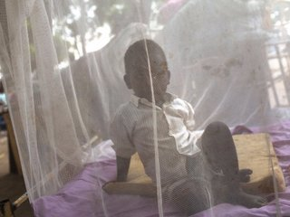
Prevention- Vector control
Sleeping under Insecticide-treated mosquito net
Insecticide remains in the net for upto 3 years
ITN responsible significant reduction in cases
Challenges : distribution and actual use
Target: entire population OR small children and pregnant women
Notes:
Map of coverage of ITNs in Kenya

Slide 37
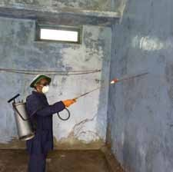
Prevention
Indoor residual spraying
Insect repellants
Protective clothing,
Housing
Prophylaxis in necessary situations e.g sickle cell disease -Atovaquone /proguanil or mefloquine
Vaccines : anti-sporozoite

Slide 38
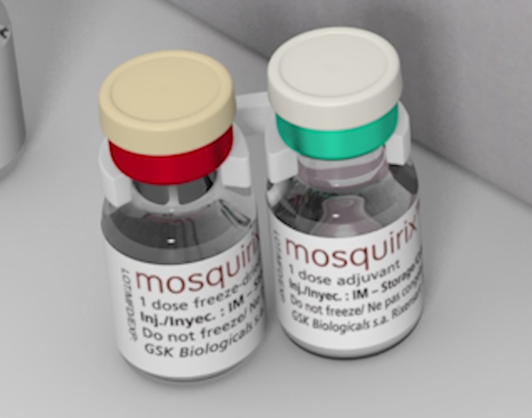
RTS,S/AS 01 (Anti-sporozoite vaccine)
RTS,S/AS01 (trade name Mosquirix™) is the first malaria vaccine to be piloted at population level
January 2016, the W.H.O published position paper on RTS,S
Pilot implementation of the vaccine in African settings of moderate-to-high transmission.
RTS,S is considered as the first generation and there is effort for development of the second generation.

Slide 39
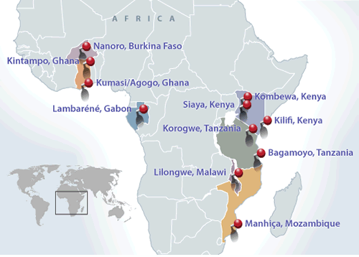
Malaria vaccine initiative: sites

Slide 40
W.H.O position on pilot implementation
Use the 4-dose schedule of the RTS,S/AS01 vaccine in 3–5 settings in sub-Saharan Africa covering moderate-to-high transmission
Ghana, Malawi and Kenya
Three doses administered to children between 5 and 9 months of age, followed by a fourth dose 15–18 months later.
Minimum interval between doses of 4 weeks
RTS,S/AS01 can be co-administered with other vaccines in national immunization program

Slide 41
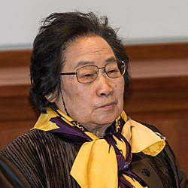
Tu Youyou's Nobel Peace prize 2015
Chinese pharmaceutical chemist and educator.
Best known for discovering artemisinin ( qinghaosu) and dihydroartemisinin.
Discovery regarded as a significant breakthrough in 20th Century

Slide 42
Thank you

Slide 43
Malaria and sickle cell disease
Sickle cell trait protective
Lower rates of admission from malaria
Lower incidence of severe malaria
Increased sickling –early senescence of phagocytosed erythrocytes
Reduced parasite invasion and retarded development
Sickle cell disease –worsens malaria
Higher mortality from malaria
Higher incidence of bacteremia

